Slide 1

PROJECT-123
SENTIMENT ANALYSIS ON IPHONE_4s

Slide 2

.
GROUP 03
PRESENTED BY: Deepak Baliram Talekar Deepak C N Harsh Suvarna Krishna Prasad Sourav Shivkumar Shukla Sowmiya S Vrushabh Dipak Patil
.
GUIDED BY:
Neha Ramachandani

Slide 3

OBJECTIVES:
In this project, we aim to perform Sentiment Analysis on Iphone 4s Product reviews.

Slide 4
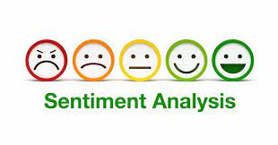
PROJECT MILESTONES:
INITIAL ANALYSIS(EDA), FEATURE ENGINEERING
BUSINESS UNDERSTANDING
COLLECTION OF DATASET
MODEL DEPLOYMENT
MODEL BUILDING

Slide 5
WHAT IS SENTIMENT ANALYSIS:
Sentiments are feelings, opinions, emotions, likes/dislikes, good/bad.
Sentiment Analysis is a Natural Language Processing and Information Extraction task that aims to obtain writer's feelings expressed in positive or negative comments, questions and requests, by analyzing a large numbers of documents
Sentiment Analysis is a study of human behavior in which we extract user opinion and emotion from plain text. Sentiment Analysis is also known as Opinion Mining

Slide 6
WHAT IS SENTIMENT ANALYSIS:
It is a task of identifying whether the opinion expressed in a text is positive or negative.
Automatically extracting opinions, emotions and sentiments in text.
Language-independent technology that understand the meaning of the text.
It identifies the opinion or attitude that a person has towards a topic or an object.

Slide 7
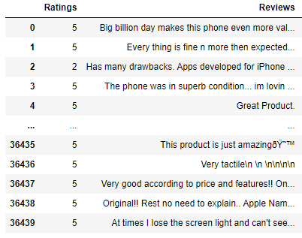
DATA SET:
Data set includes 36440 rows and 2 columns

Slide 8
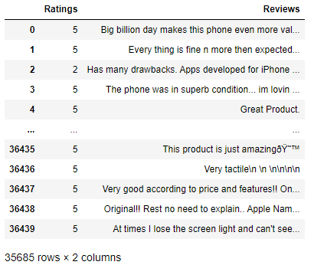
DATA SET:
After removing the Null Values, remaining data is 35685 rows and 2 columns

Slide 9
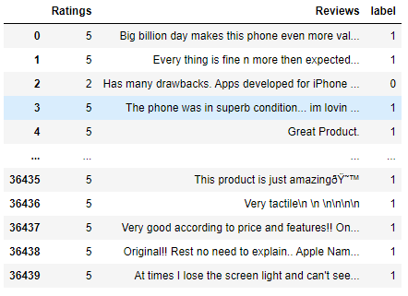
LABELLING REVIEWS:
The reviews with star rating 4,5,3 are labelled as positive reviews and 1,2 are labelled as negative reviews.

Slide 10

PRE-PROCESSING:
Convert the all reviews into the lower case.
Remove the HTML tags and URLs from the reviews by importing Beautiful Soup

Slide 11
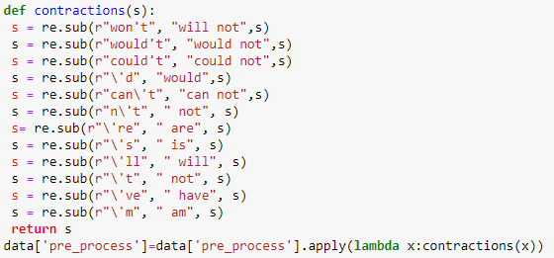
PRE-PROCESSING:
Perform the Contractions on the reviews.

Slide 12
PRE-PROCESSING:
Remove non-alpha characters
Remove the extra spaces between the words

Slide 13
PRE-PROCESSING:
Remove the stop words by using the NLTK package
Perform lemmatization using the wordnet lemmatizer

Slide 14
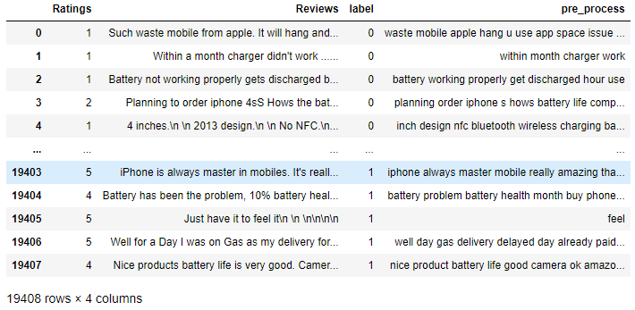
PRE-PROCESSING:
After converting all the reviews into the lower case. Removed the HTML tags and URL, Non-alpha characters, extra space between the words and the stop words by using NTLK package. Performed the constractions and Performed lemmatization using the wordnet lemmatizer the final dataset will be

Slide 15
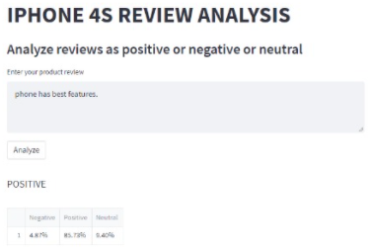
MODEL DEPLOYMENT:
After the Model building and Evaluation process, we have deployed the code using “spyder”.

Slide 16
CONCLUSION:
In this project, we developed a system that extracts potential features from a text and clusters opinion expressions describing each of the features. It finally retrieves the opinion expression describing the user specified feature.

Slide 17


